Slide 1
Basic characteristics of computer network
Dr.Mohammed Abdalla Mahmoud Youssif
1

Slide 2
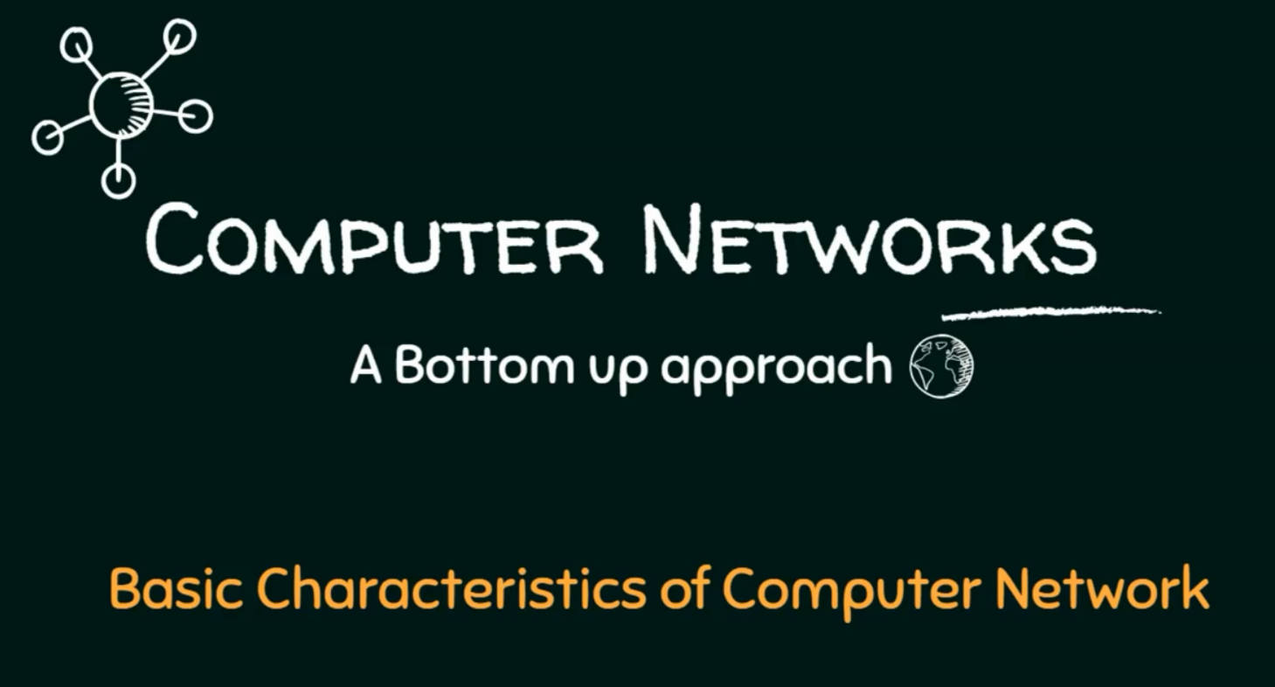
2
Notes:
2

Slide 3
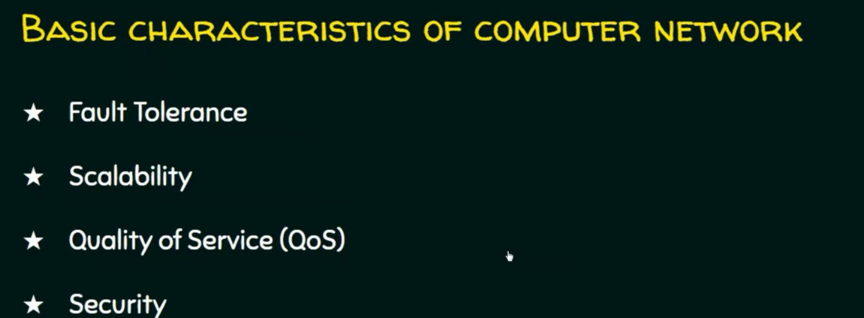
3
Notes:
3

Slide 4
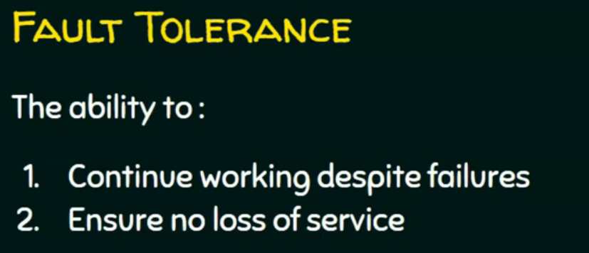
4
Notes:
4

Slide 5
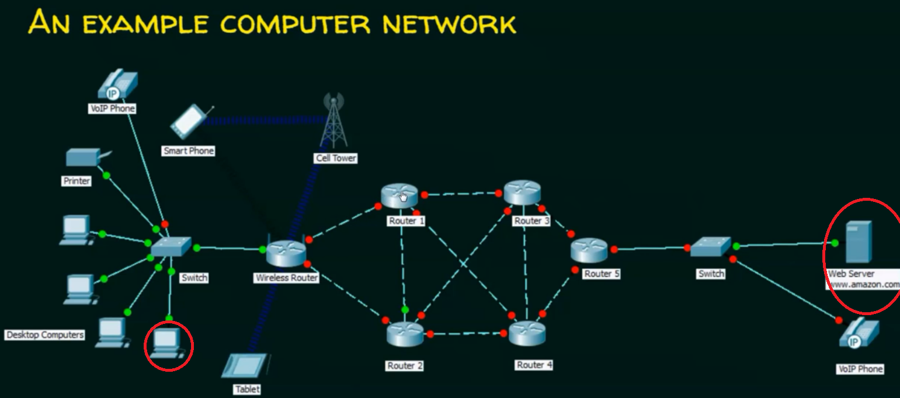
5
Notes:
assume that there is failure in some link → the network must able to proceed and deliver.
5

Slide 6
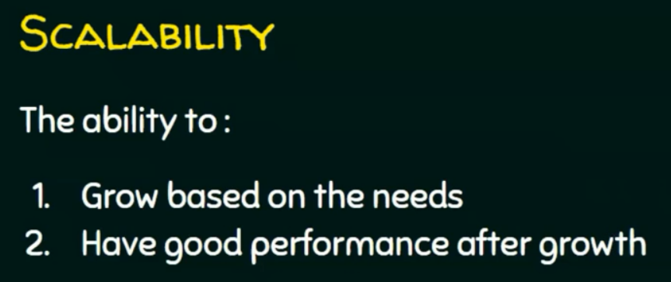
6
Notes:
6

Slide 7
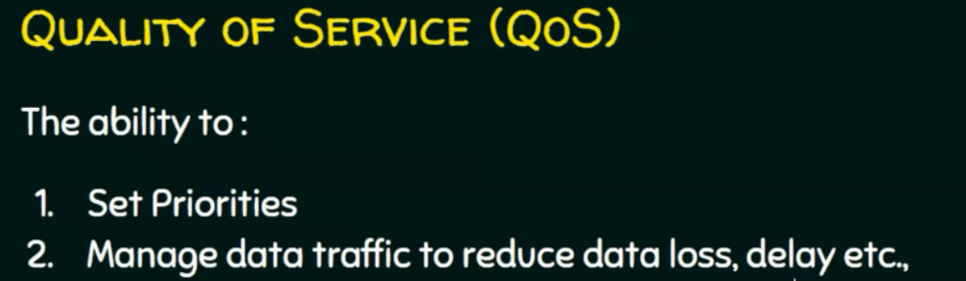
7
Notes:
7

Slide 8
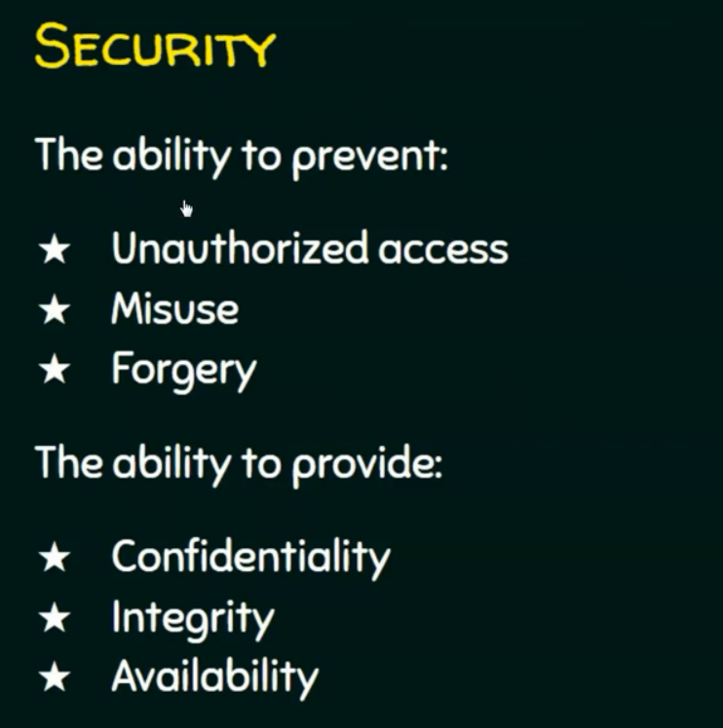
8
Notes:
8

Slide 9
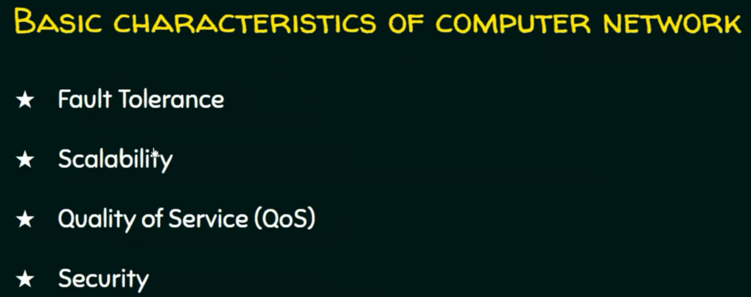
9
Notes:
9

Slide 10
Questions ?
10
Notes:
10

